Slide 1
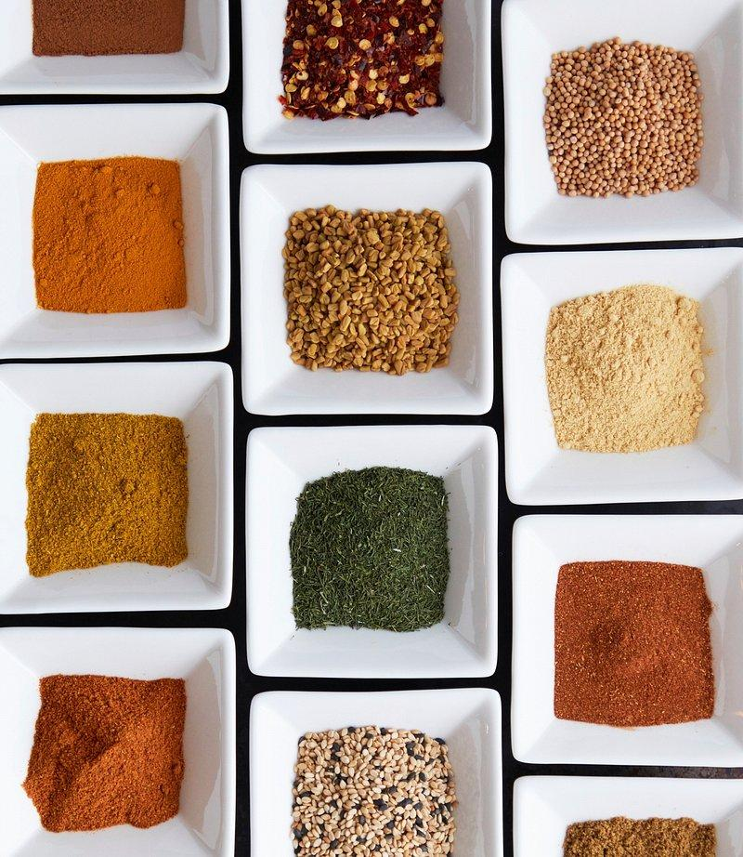
Recipe Recommendation System
Amari Parris, Parth Malik, Yaseen Ellison

Slide 2
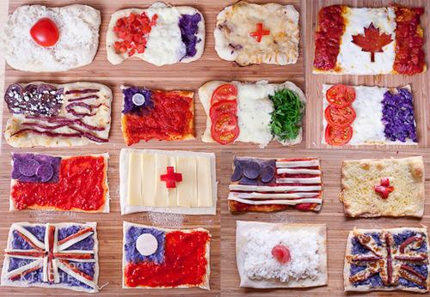
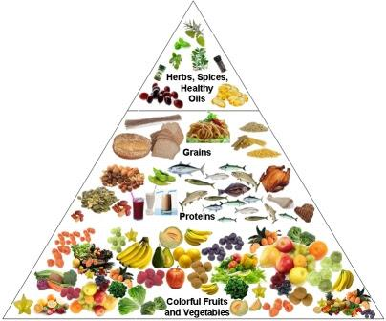

Problem Statement:
As a Data Science Team within a Culinary Discovery Platform, our mission is to enhance the digital culinary experience by navigating the vast landscape of online recipes. We aim to develop a system that intelligently categorizes recipes based on their ingredient profiles and culinary styles, enabling users to explore new dishes that align with their taste based on whatever they have on hand.
Cuisine Types
Ingredient Types
User Tastes

Slide 3

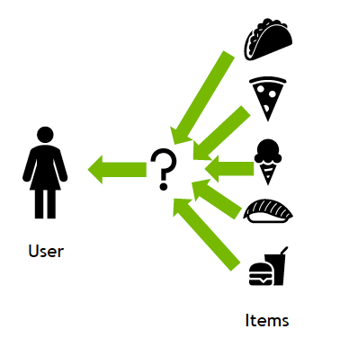
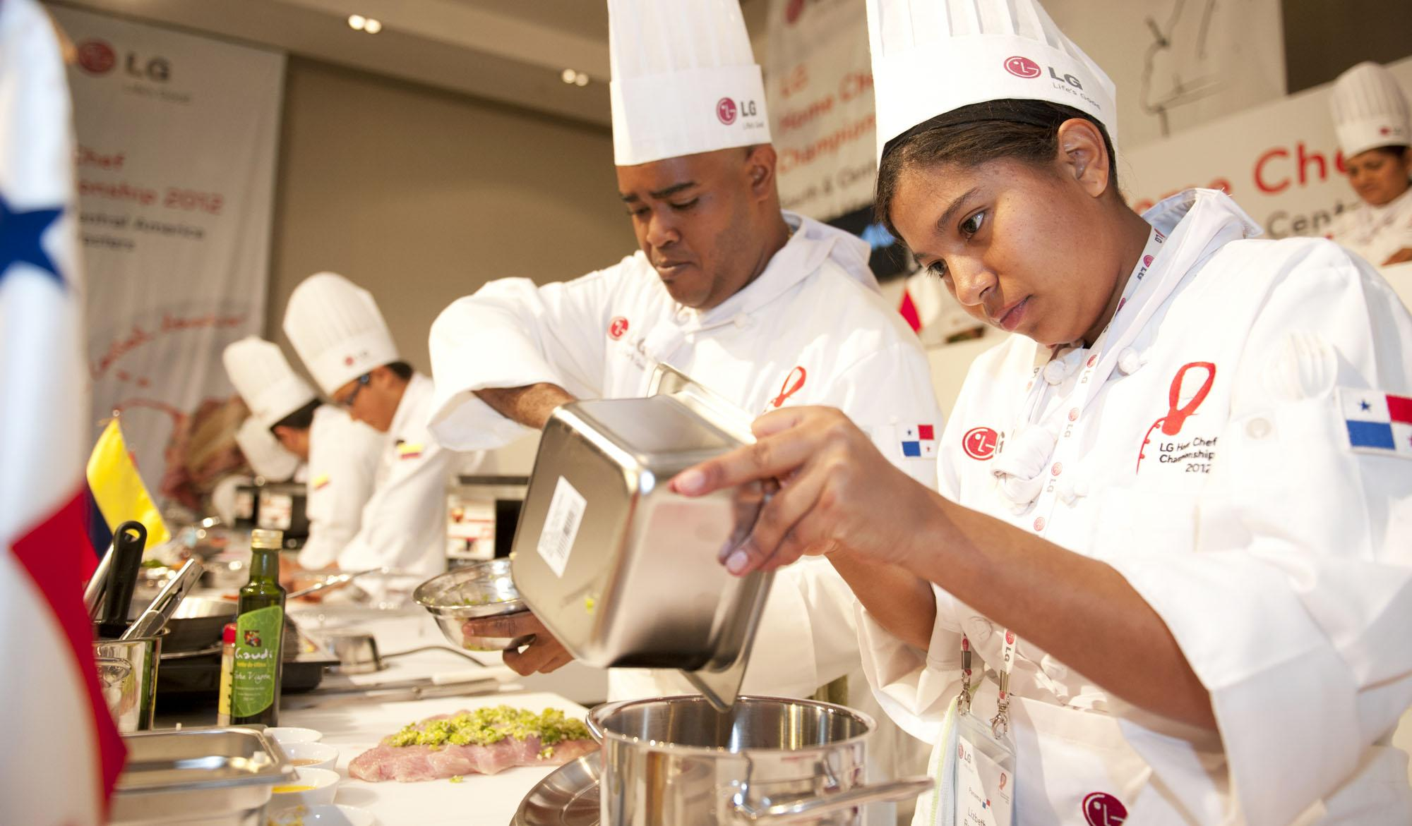
Planned Approach:
Advanced Insights and Analytics: Undertake an analysis of ingredient co-occurrence within the clusters to pinpoint distinctive combinations that typify particular cuisines and/or reflect emerging dietary trends.
Recommender System: Craft a content-based filtering mechanism that suggests recipes to users by drawing parallels in ingredients, cooking methodologies, and individual preferences. This recommendation engine will leverage the clusters formulated through unsupervised learning techniques to deliver tailored suggestions.
Advanced Insights and Analytics
Recommender System

Slide 4

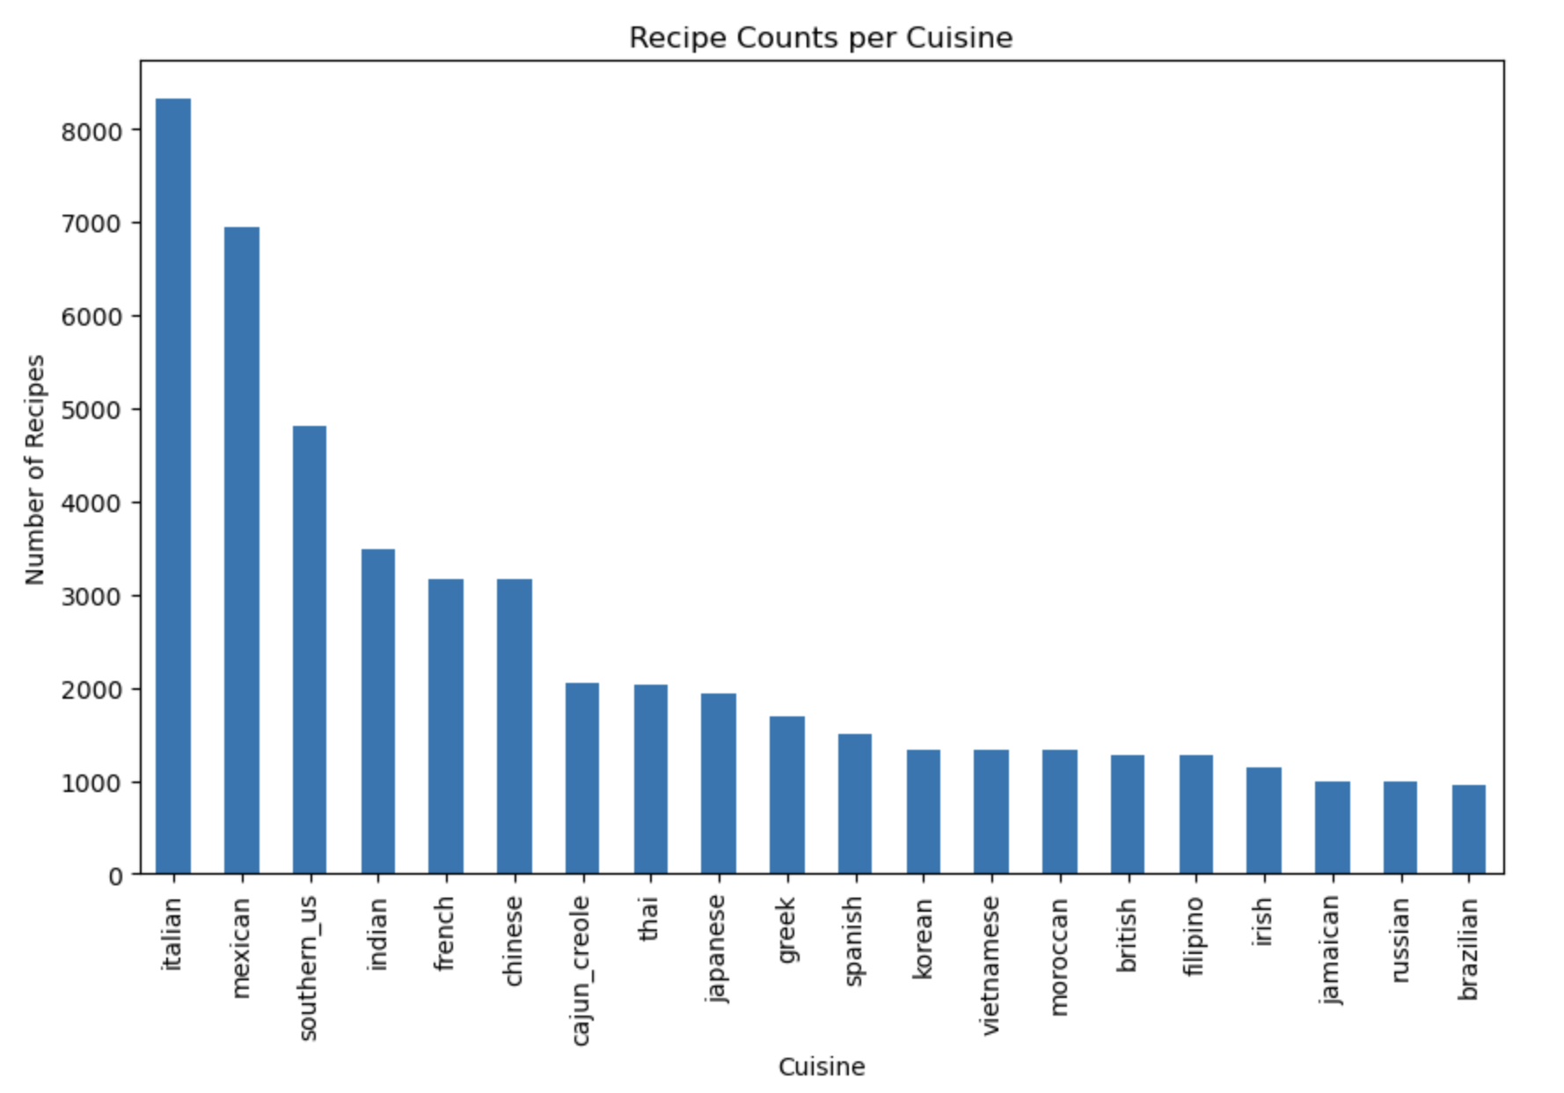

Our Data:
Data Description:
- approx. 50,000 aggregated recipes, scraped from the web.
- 7,000 Unique Ingredients after pre-processing.
- Custom Recipe Naming Function.
Dataset is very sparse. Had to consider techniques that will handle well.
Limitations:
Limited number of non-numeric features
Heavy reliance on clustering to identify regions of interest in our dataset to drive recommendation system fine tuning.
Emphasis on creativity in recommender system logic to build nuance; input handling and deriving relationships from EDA to incorporate both region/style and ingredients based recommendations
Considered pseudo taste-profiles, but wanted to grade based on inputs and applicability.

Slide 5
System Infrastructure:
Data Preprocessing
Feature Extraction
Dimensionality Reduction
PCA Results
SVD Matrices
User-input Ingredients
K-Means Clustering
Post Clustering EDA
Recipe Matches Filtered based on taste
User Tastes

Slide 6
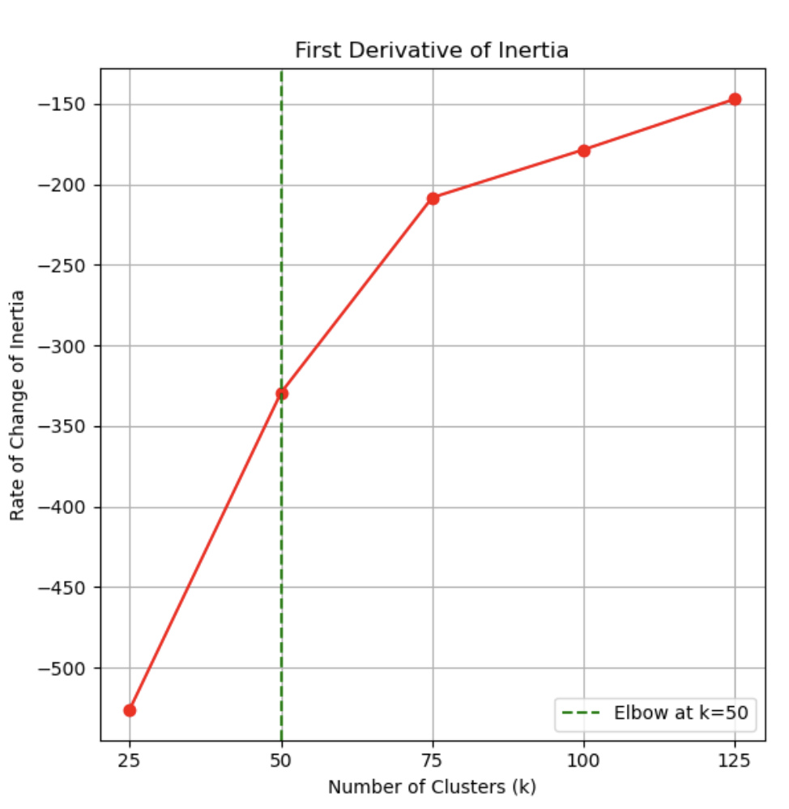
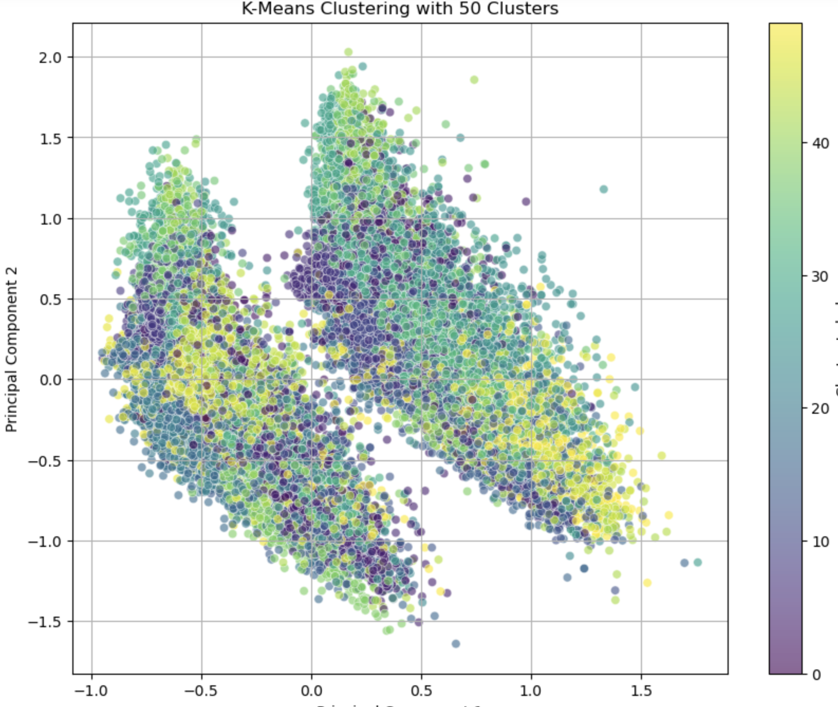
PCA + K-Means: Dimension Reduction & Clustering
700 components at 85% explained variance
Elbow Method & Derivative of curve to determine k

Slide 7
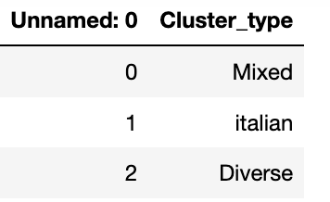
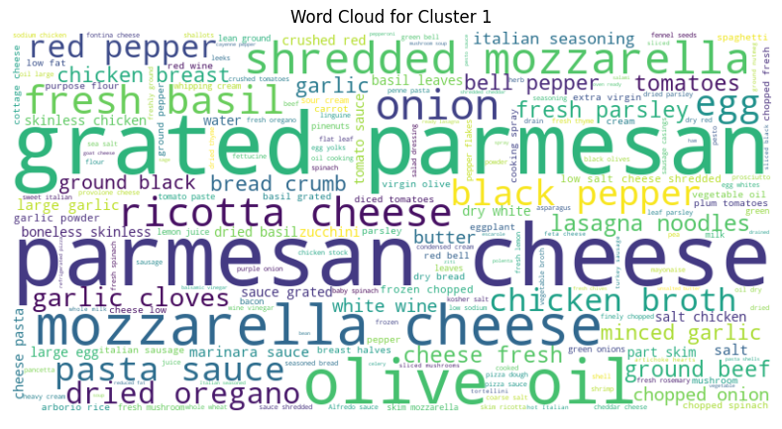
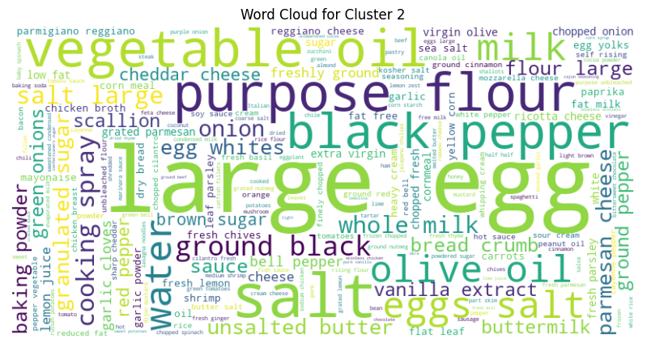
Results of Clustering Analysis
- Cluster segmentation seemed to be based on ingredient-based differences, rather than cuisine differences.
- Some Clusters are Cuisine Dominated, some show cuisine diversity. Clusters do seem to capture “themes”
- Dominated, Mixed, Diverse.

Slide 8
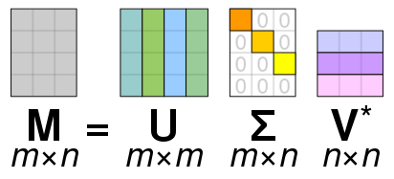
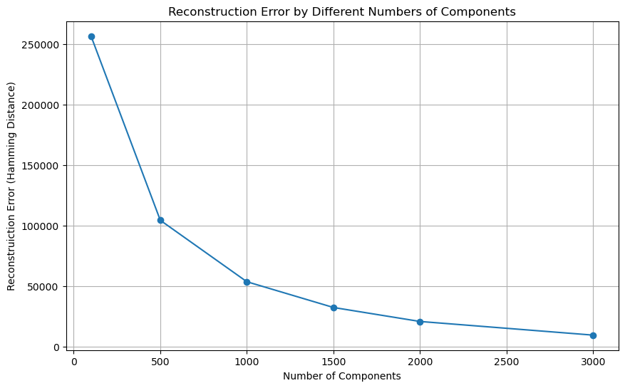
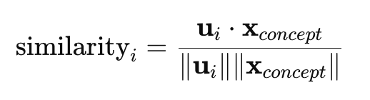
SVD: Rec System
Given binary and sparse data Hamming Distance was used as measure of reconstruction error to determine the number of components in truncated SVD.
1000 components selected for recommendation system with reconstruction error of < 1%.
[100010]
xconcept= x • V
Further filtering via cluster labels
1. Accept User Input
4. Return Top Recipes
2. Project Input Onto Concept Space
3. Calculate Similarity Scores
User Input must be in binary structure corresponding to ingredients in original Matrix.
Project the binary input vector onto the latent semantic space using the V matrix ( the transpose of V^{T}):
Calculate cosine similarity between resulting xconcept, and all recipes in U matrix.
Select the top N recipes based on their similarity scores. These are the recipes that are most similar to user’s input.

Slide 9
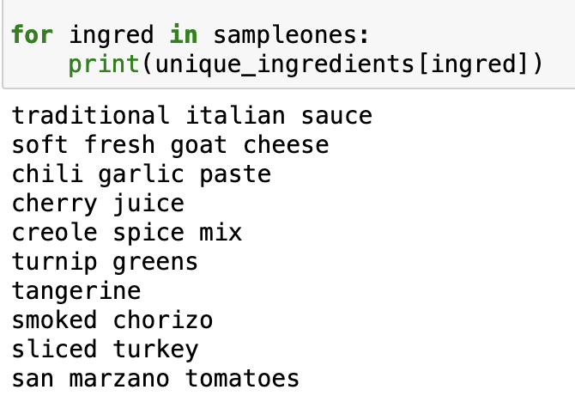
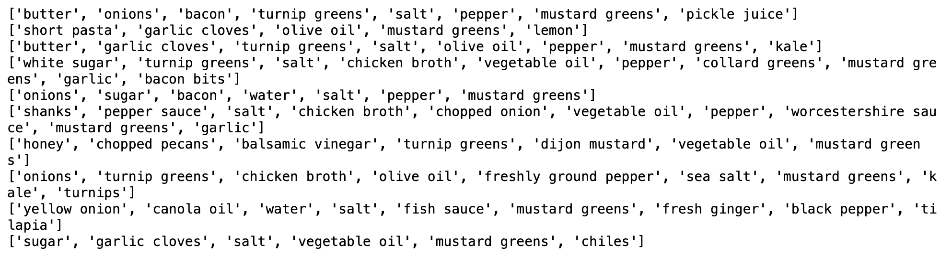
Baseline Recommendations
- Sample randomized ‘ingredient list’.
- May not have the “essence” real recipes have.
- Further Nuance will come from how we handle our input preference in relation to our Clusters
[10000010011000011000001001100001]

Slide 10
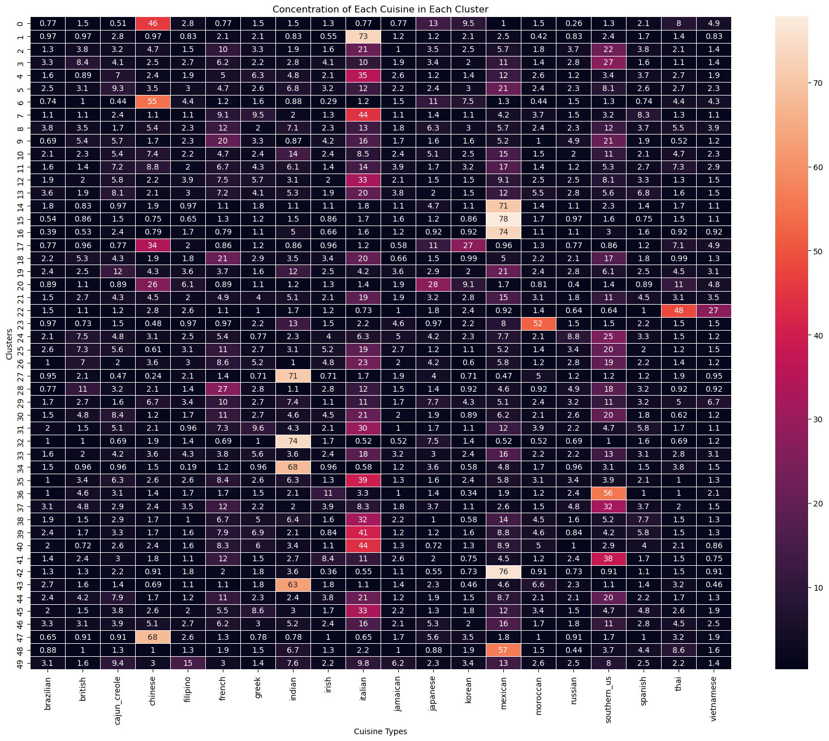
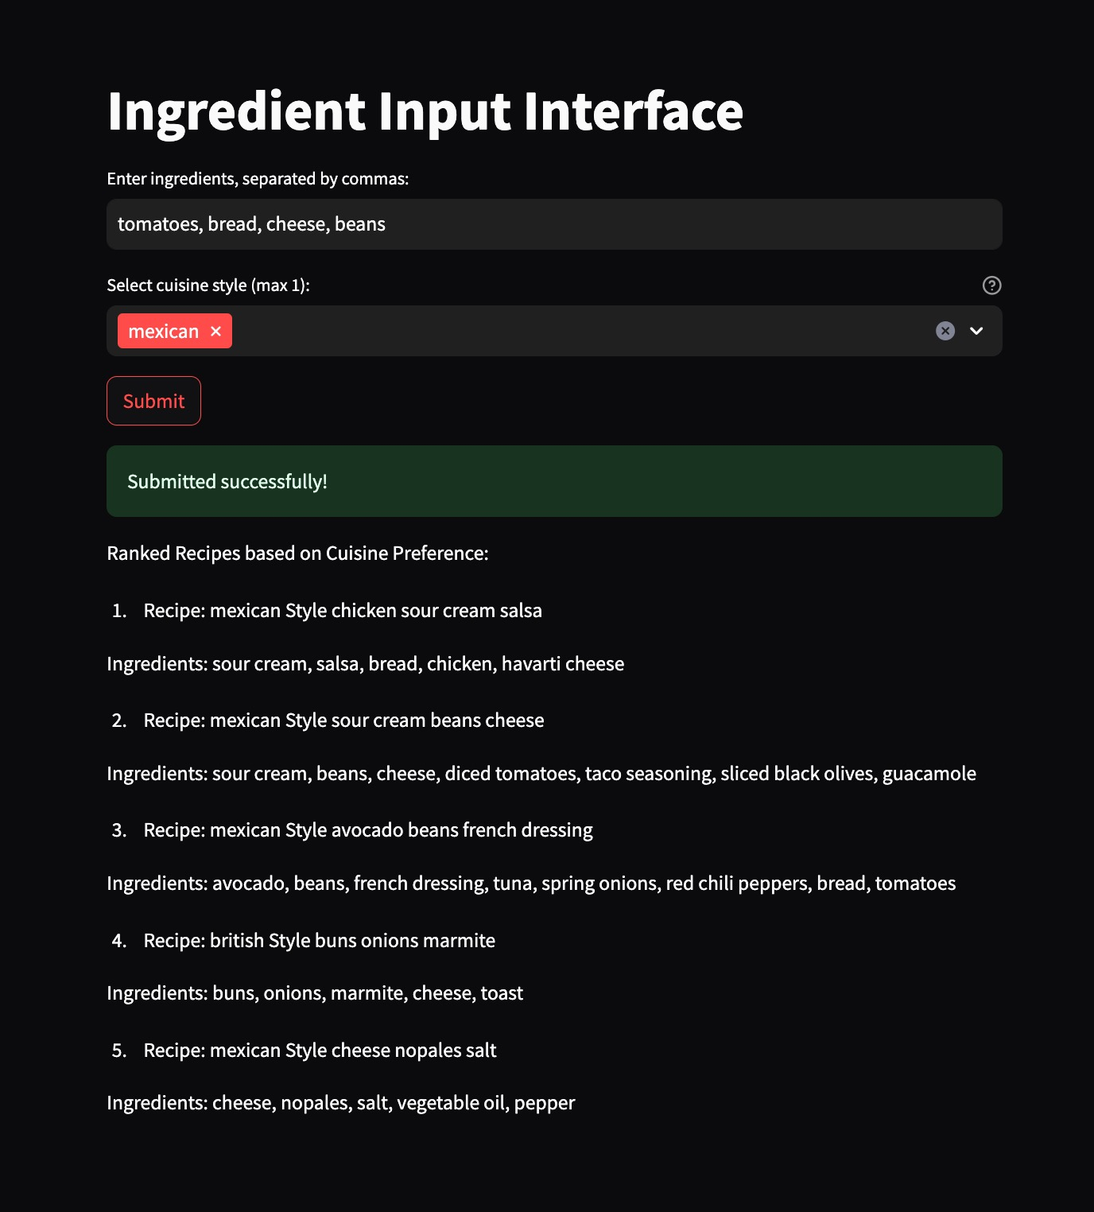
Rec System + Clustering
- Fuzzy Words Edit Distance: Map input strings to ingredients in our ingredients set.
- Implemented Clustering into Filtering: Cuisine style concentration calculated per cluster to rank recommendations according to user style preference.
Ex. If I choose mexican as my taste of choice, the recommender identifies the levels of “mexicanness” in each cluster that my recipes belong to and ranks them accordingly.

Slide 11
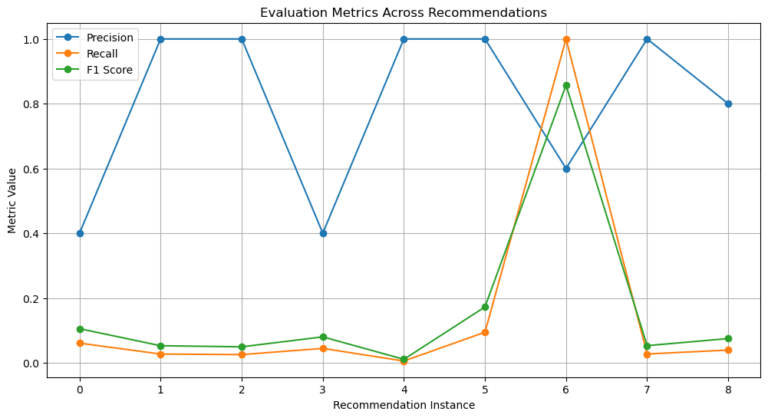
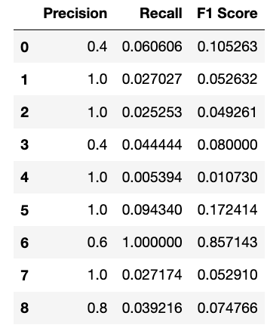
Rec System Grading & Performance
Ground truths are determined based on the criteria that a recommended recipe is considered relevant if it meets the following conditions:
Cuisine Match: The recipe belongs to the specified cuisine style (e.g., Italian, French, etc.).
Ingredient Match: The recipe contains at least two ingredients that were included in the user's input list.
High precision suggest recommendation system is successful in producing recipes that meet the users preferred taste in most cases
relatively low recall suggest more relevant results are available that are not being captured
More Cuisine/style specific evaluation is needed

Slide 12
Future Directions and System Improvements
Historic User Data: incorporate user ratings/ existing taste to make better personalized recs.
Unified Ingredient Representation:Develop a more sophisticated ingredient normalization process to handle variations more effectively ('sugar' vs. 'granulated sugar')
Ingredient Synonym Mapping: Implement a comprehensive synonym mapper to group similar tasting ingredients, enhancing the system's understanding of flavor profiles and recipe substitution possibilities."
Broader Ingredient and Recipe Database: Expand the dataset to include a wider range of recipes and ingredients from various global cuisines, increasing the diversity and appeal of the recipe recommendations.

